Slide 1
LOGIN AUTHENTICATION
TEAM DETAILS:
JASHAN JOT KAUR GILL[2210990436]
JASHANPREET SINGH[2210990439]
JASHANJIT KAUR[2210990440]
JASHANJOT SINGH[2210990441]
FACULTY COORDINATOR:
DR. CHETNA KAUSHAL
:
Chitkara University Institute of Engineering and Technology,
Chitkara University, Punjab

Slide 2
TABLE OF CONTENTS
S. No. | Topic | Page no.
1. | Introduction | 3
2. | Problem Statement | 4
3. | Technical Details | 5
4. | Key Features | 6
5. | Project Highlights | 8
6. | Conclusion | 11
7. | References/ Links used | 12

Slide 3
INTRODUCTION
LOGIN AUTHENTICATION
Login authentication is a vital process, widely followed by organizations to keep their servers safe by allowing access only to authenticated users. Every website or application demands users to complete the login authentication process to cement their credentials for security and to improve user experience. In this project users enter their email ID/username and password to log in to the site.
Verify User Identity
Prevent Unauthorized Access
Provide Personalisation
Track User Activity
Provide Security
Protect Sensitive Data
Ensure Compliance

Slide 4
PROBLEM STATEMENT
Login authentication is a critical security measure implemented in various systems and applications to protect sensitive information and ensure authorized access. Here are several reasons why login authentication is necessary:
Identity Verification: Login authentication allows the system to verify the identity of the user before granting access. By requiring users to provide credentials (such as username and password), it confirms that the person attempting to access the system is who they claim to be.
Access Control: Login authentication enables organizations to control access to their resources. By assigning unique credentials to each user, administrators can determine which parts of the system or application each user is authorized to use based on their assigned privileges.
Confidentiality and Privacy: Authentication helps maintain the confidentiality of sensitive information by preventing unauthorized individuals from accessing it. Usernames and passwords act as barriers to entry, ensuring that only authorized individuals can view or manipulate sensitive data.
Protection Against Unauthorized Access: Without login authentication, anyone could potentially access a system or application, leading to unauthorized use, data breaches, or misuse of resources. Authentication helps safeguard against these threats by requiring valid credentials for entry.

Slide 5
TECHNICAL DETAILS
HTML form: The login authentication page can be created using an html form that includes input fields for username and password in sign-in window and username, password, confirm password, and other required inputs in sign-up window. The form contains a submit button that triggers a login process.
Input fields: there are a variety of input fields used in this project like:
<input type=”text”>: For text type input like in Username.
<input type=”date”>: For a date type input which is used for the birthday date of user.
<input type=”password”>: For a password type input.
<input type=”number”>: For a number input as in weight and height.
CSS styling: CSS is used in the login form to make it visually appealing and fun to interact with. CSS is used to add rounded borders, style div containers, add colours and fonts to the web page.
Validation: The login form validates the inputs using JavaScript to ensure that the user has entered valid credentials. JavaScript is used to check that any required field is not empty.
Local Storage: Local storage is a mechanism that allows web applications to store data locally within the user’s we browser. It provides a way to persistently store key – value pairs in a simple, synchronous manner.

Slide 6
KEY FEATURES
Username/Email Field: The most fundamental feature of login authentication is the requirement for users to enter a unique username, email address.
Password Field: A secure field where users enter their corresponding password. Passwords is masked or hidden as the user types for added security.
Sign-In Button: A prominent "Sign In" or "Log In" button is provided to initiate the authentication process. Clicking this button submits the entered credentials for verification.
Forgot Password Link: A link or button labelled "Forgot Password" is included to help users recover their account in case they have forgotten their password. Clicking this link sends an email with instructions for resetting the password.
Sign-Up/Registration: For new users who don't have an account yet, a "Sign Up" or "Register" link/button is typically provided. Clicking this link redirects users to a registration page where they can create a new account by providing necessary details such as name, email address, and choosing a password.
Error Messages: In case users enter incorrect or invalid login credentials, the sign-in page displays informative error messages to indicate the issue. These messages help users troubleshoot and correct any mistakes made during the login process.

Slide 7
KEY FEATURES
Input Fields: The main elements on the sign-in page are the input fields where users enter their login credentials. These fields consists of:
Username
Password
Gender
Date of Birth
Feedback form: It allows customers to express their satisfaction or dissatisfaction with the services or overall experience. Provides valuable Insights into the strengths and weaknesses of services.

Slide 8
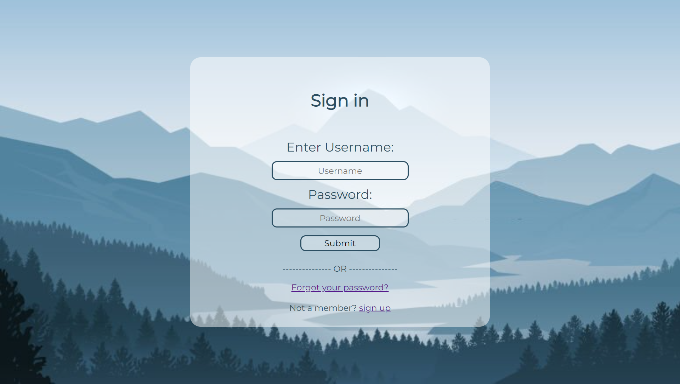
PROJECT HIGHLIGHTS
i. Sign-in :

Slide 9
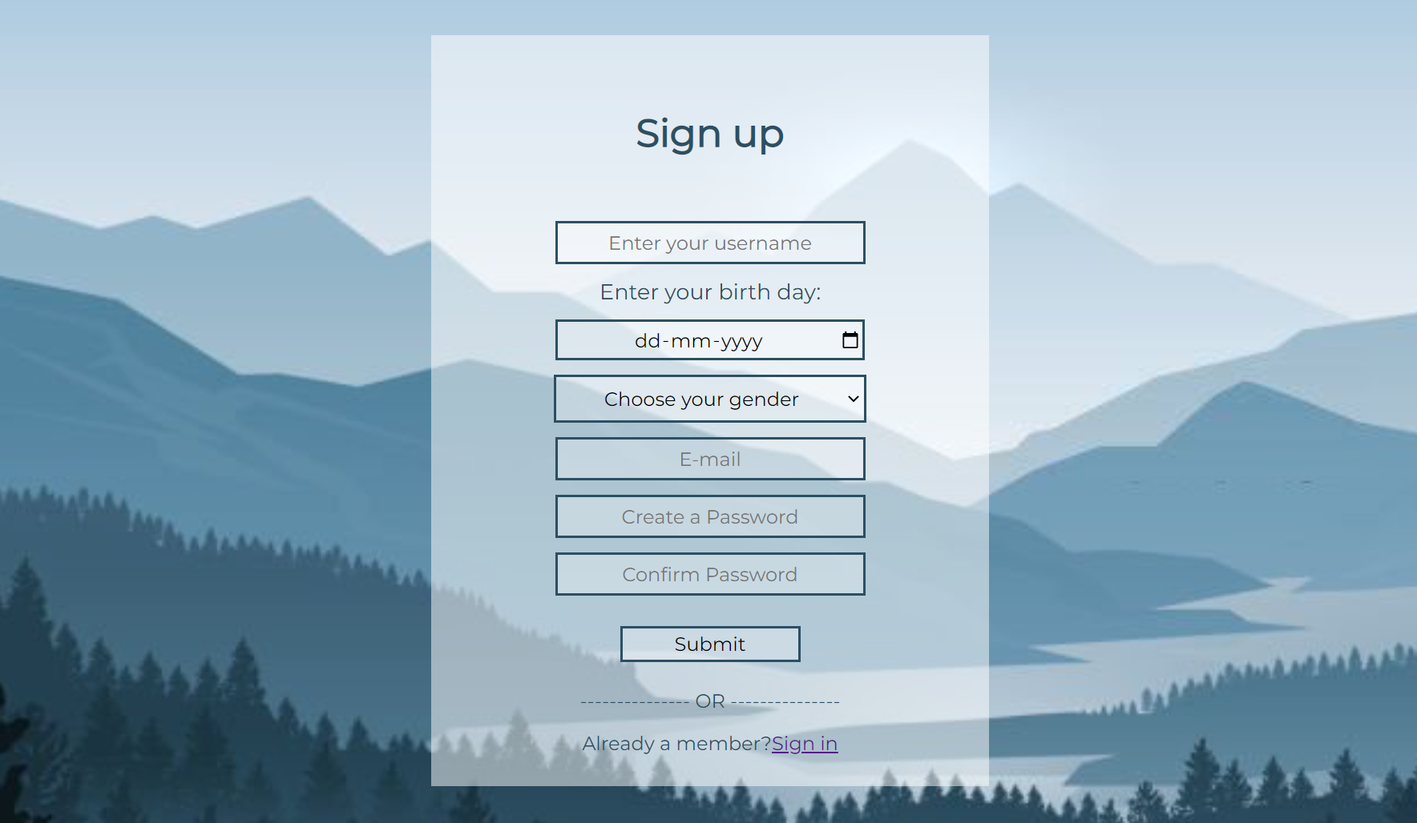
ii. Sign-up:

Slide 10
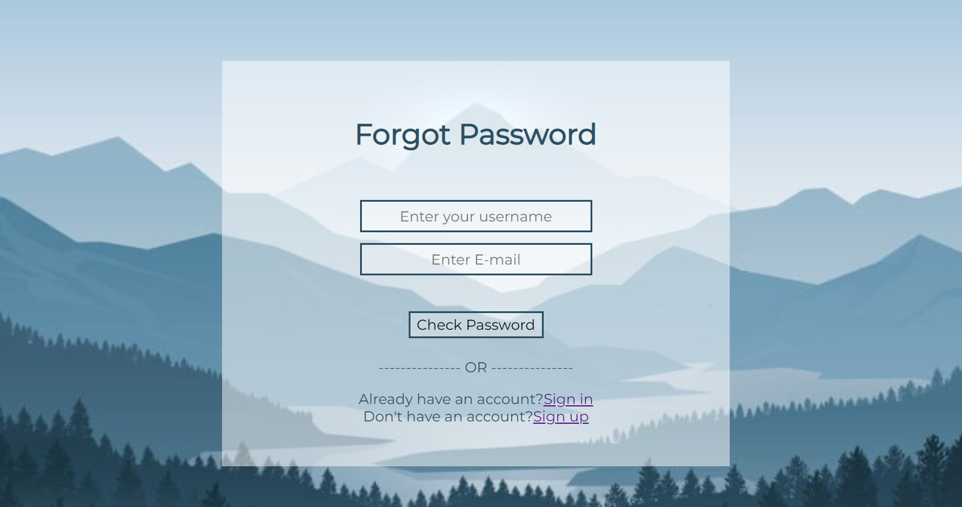
Forgot Password:

Slide 11
CONCLUSION
In conclusion, implementing a robust login authentication system is vital for ensuring the security, privacy, and integrity of user accounts and the associated data. By requiring users to authenticate themselves with unique credentials, such as a username/email and password, login authentication provides a crucial layer of protection against unauthorized access.
It enhances security by verifying user identity, protects personal information, and promotes user accountability. It also enables a personalized user experience, secures data transmission, and offers additional security layers through features like two-factor authentication (2FA).
login authentication systems assist with password management, comply with relevant regulations, and establish trust between users and the system or service. They play a crucial role in maintaining the integrity of user accounts, preventing unauthorized access and misuse, and ensuring a secure and seamless user experience.
By implementing strong login authentication measures, organizations can safeguard their users' accounts, protect sensitive data, and mitigate security risks. It is an essential component of any modern system or service that prioritizes user security and privacy.

Slide 12
REFERENCES/LINKS USED
HTML Tutorials W3schools-
https://www.w3schools.com/html/
CSS Tutorials W3schools-
https://www.w3schools.com/css/
JavaScript W3schools-
https://www.w3schools.com/js/default.asp
YouTube- APNA college-
https://www.youtube.com/watch?v=HcOc7P5BMi4
Google FONTS-
https://fonts.google.com/

Slide 13


